Slide 1
EXPLORE AND
EXPERIMENT
Elzbieta skorska

Slide 2

Place and Space?
What place and space are to me?
Space : outward and inward
Place = creation, inspiration, satisfaction
Space = POTENTIAL
PLACE = Big bang of ideas exploding into something (ideas of love, family, friendship, art, serenity or anything else you can imagine)
Place is where everything comes together
Exploring options and experimenting

Slide 3
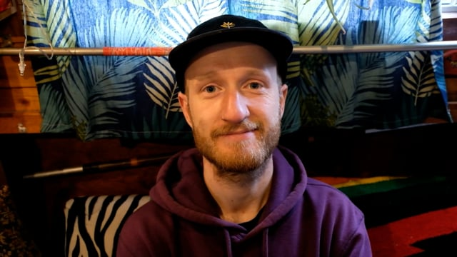
Interview on Place and Space
Aim - create a collection of potential meanings of these two words and reveal how we sometimes see the world entirely differently when looking at/thinking of the same thing. I aspired to determine that we have alternate realities within the reality that we all agree upon.

Slide 4
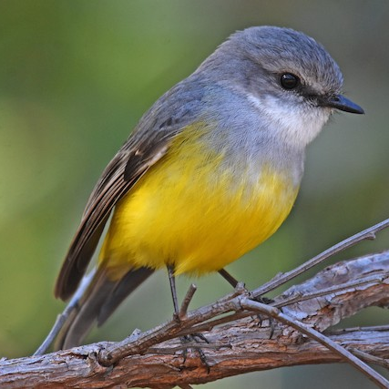
DUST
“Destruction is also creation.”
Marcel Duchamp
Going with the flow even if it's a complete diversion from a set idea
Experimenting and embracing challenge
Hoover + killed bird = concept
Reflection on life and death
Decision on making a book that sheds a different light on LIFE AND DEATH

Slide 5
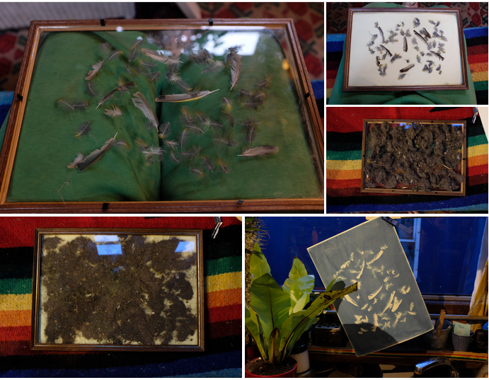
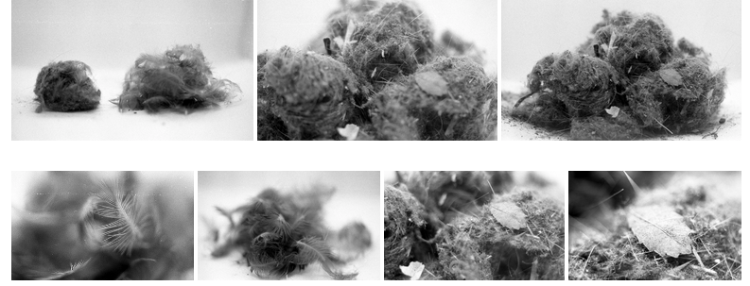
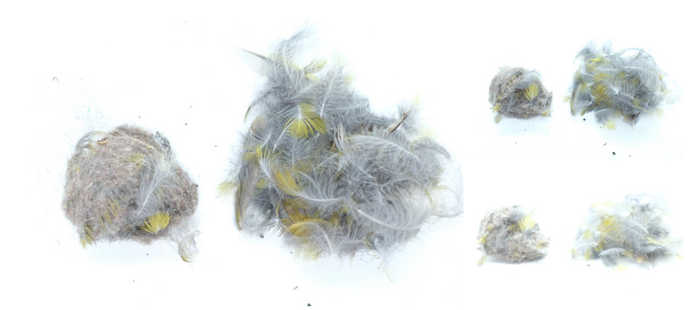
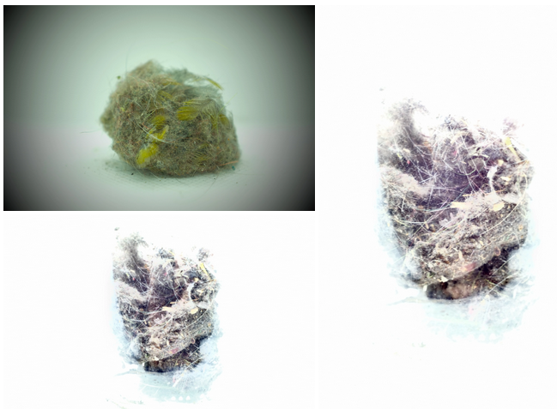
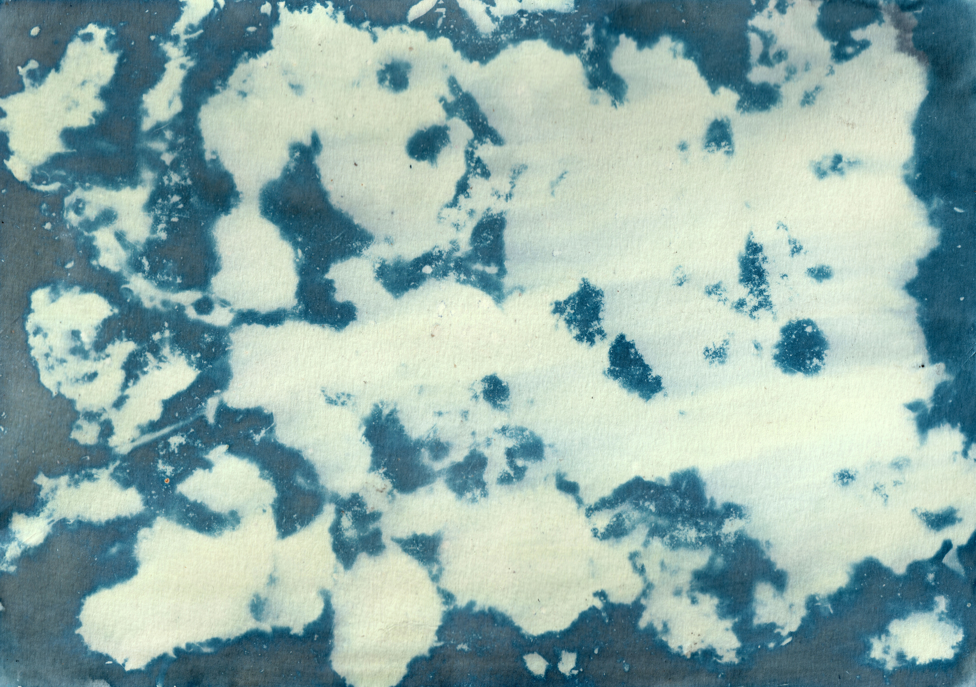
Experimentation

Slide 6
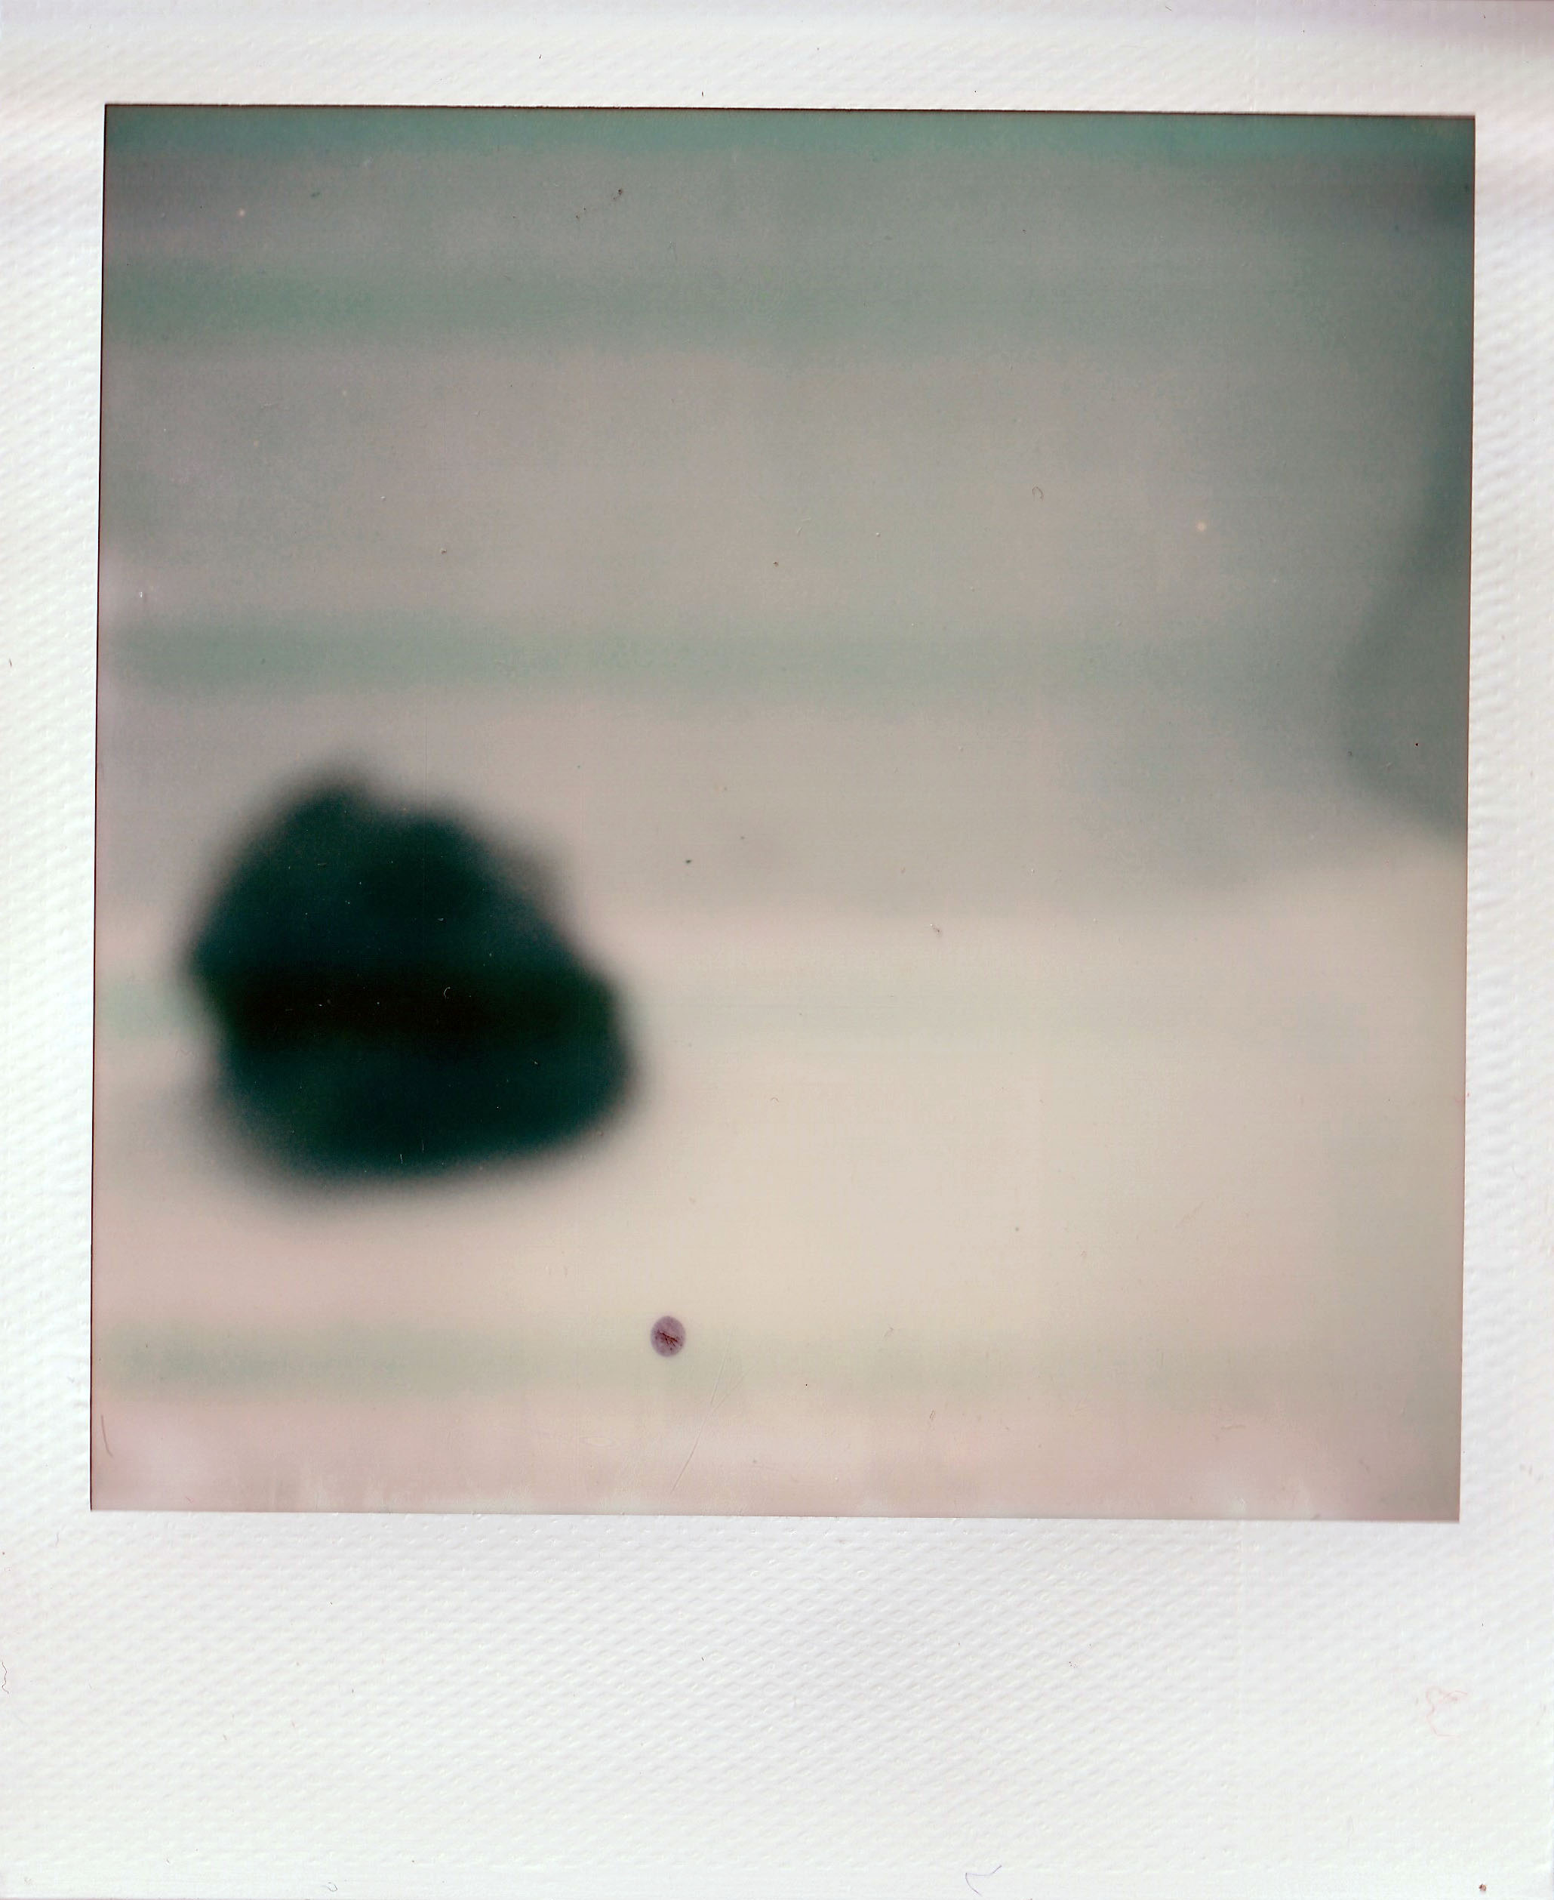
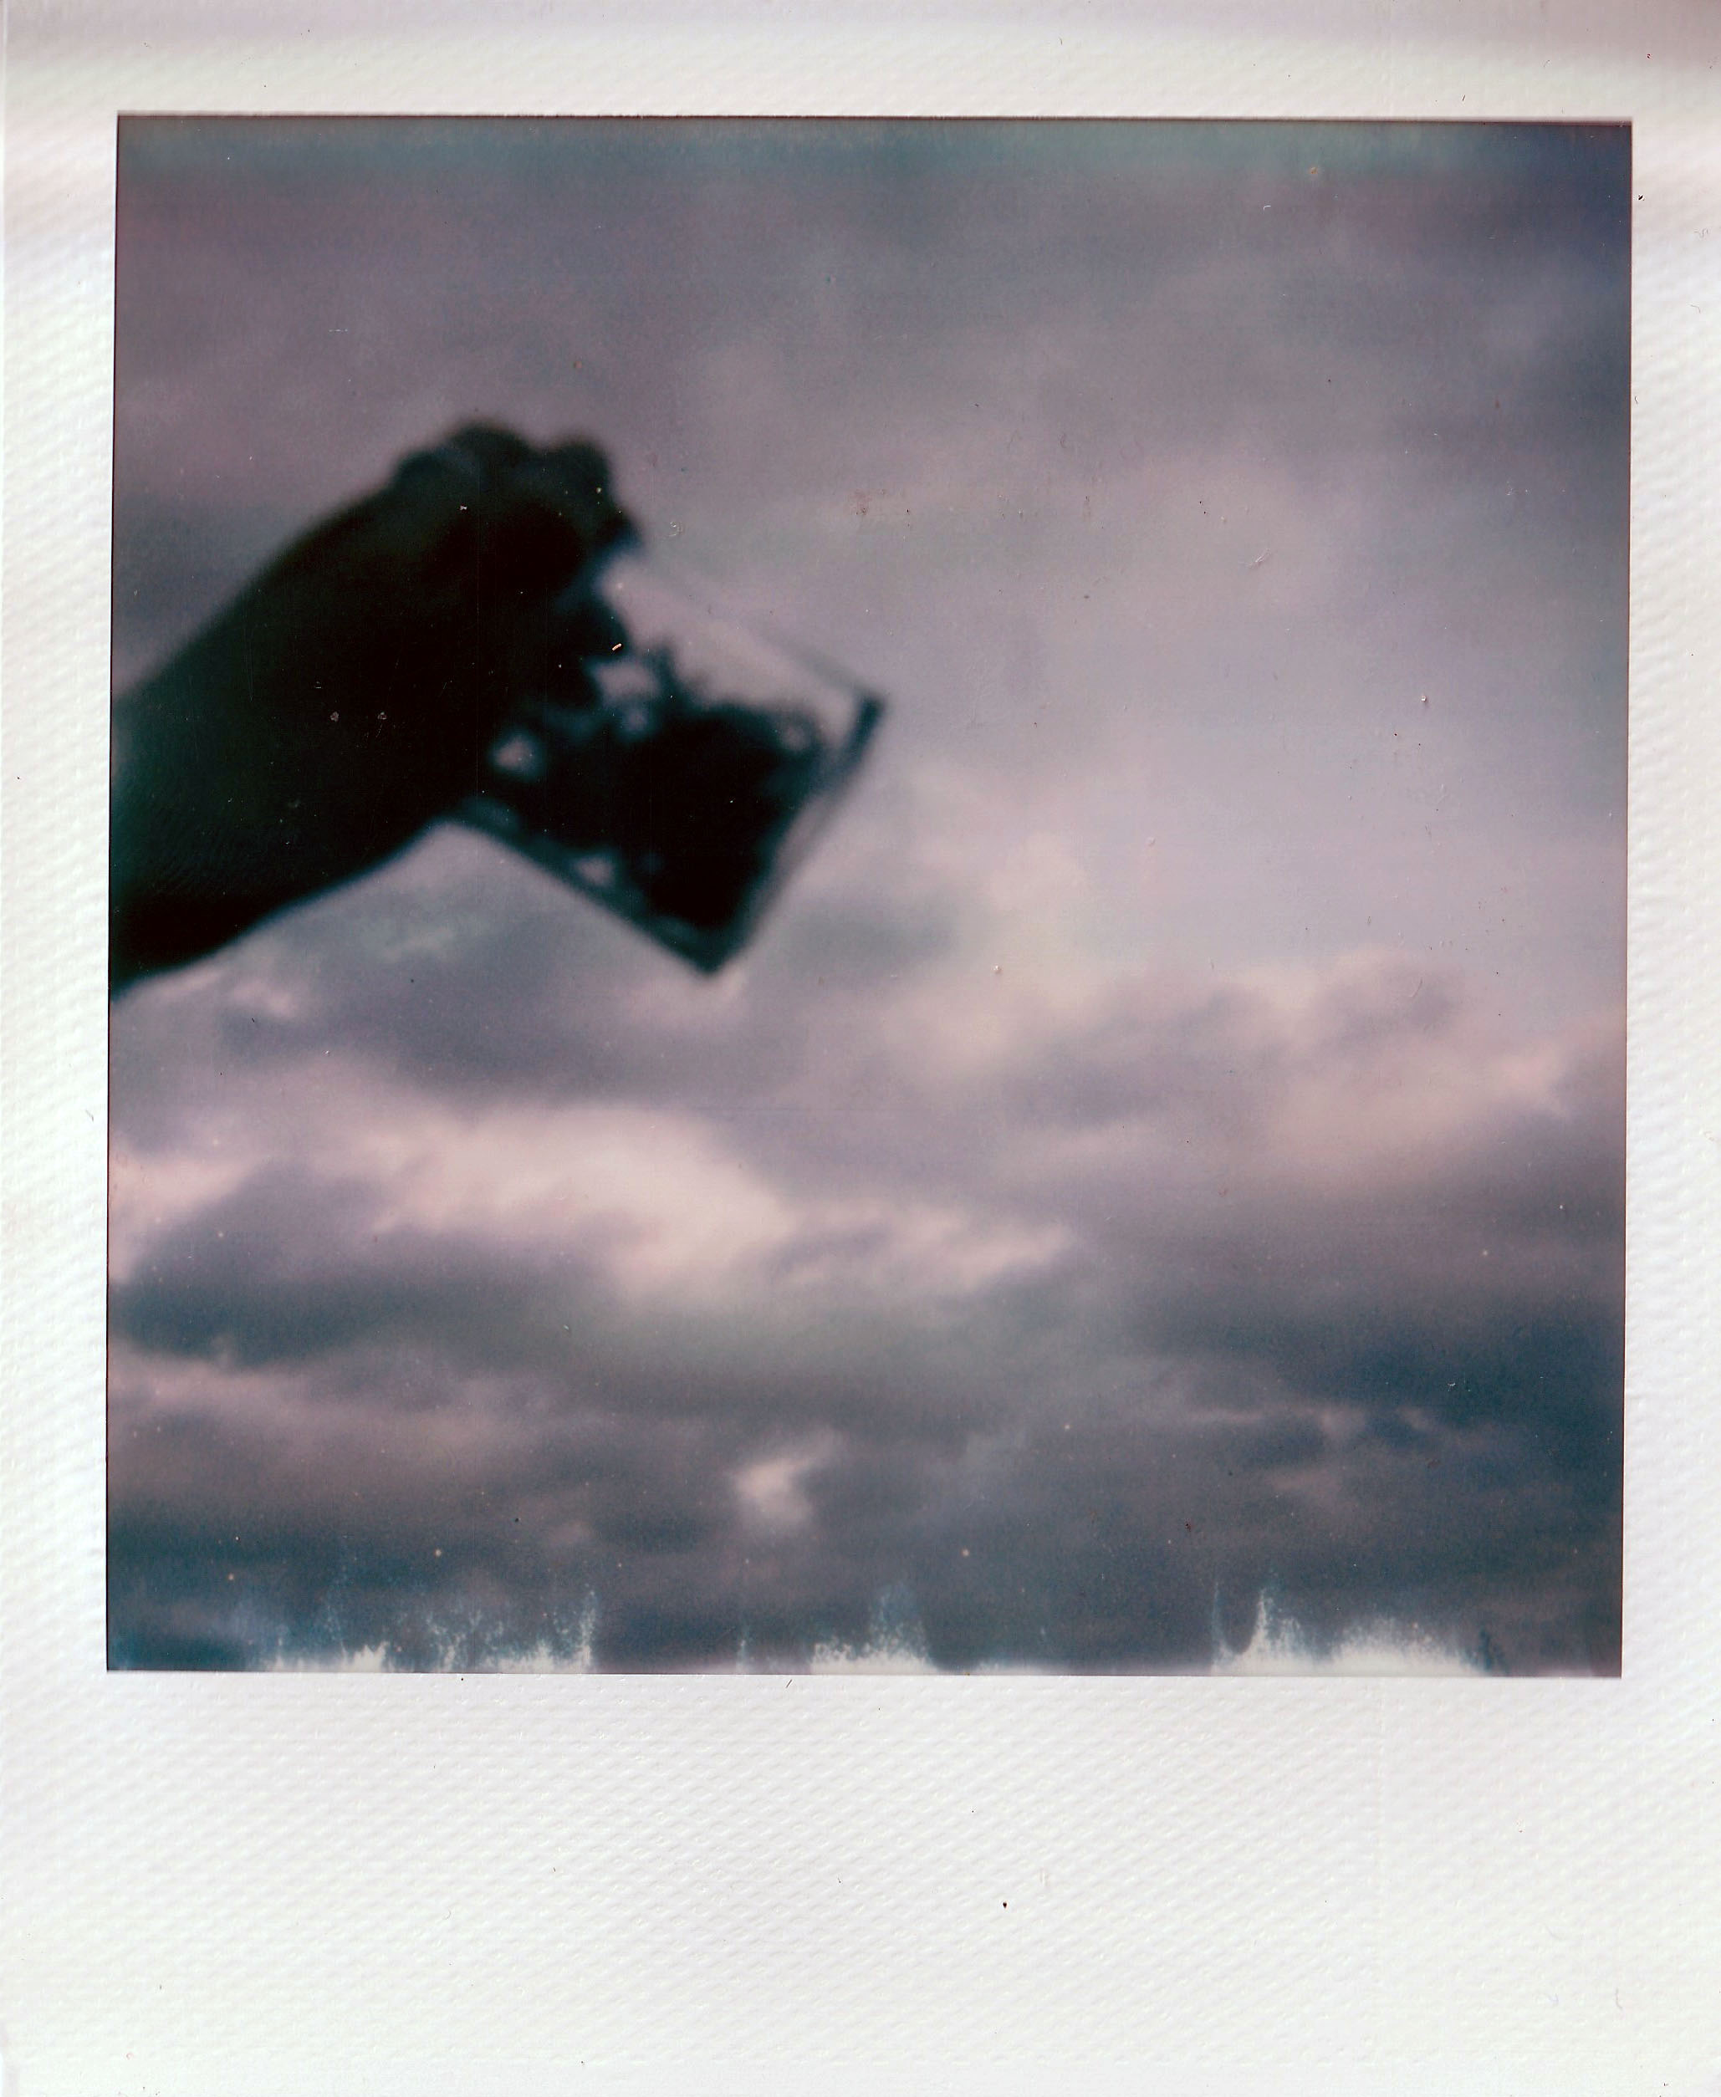
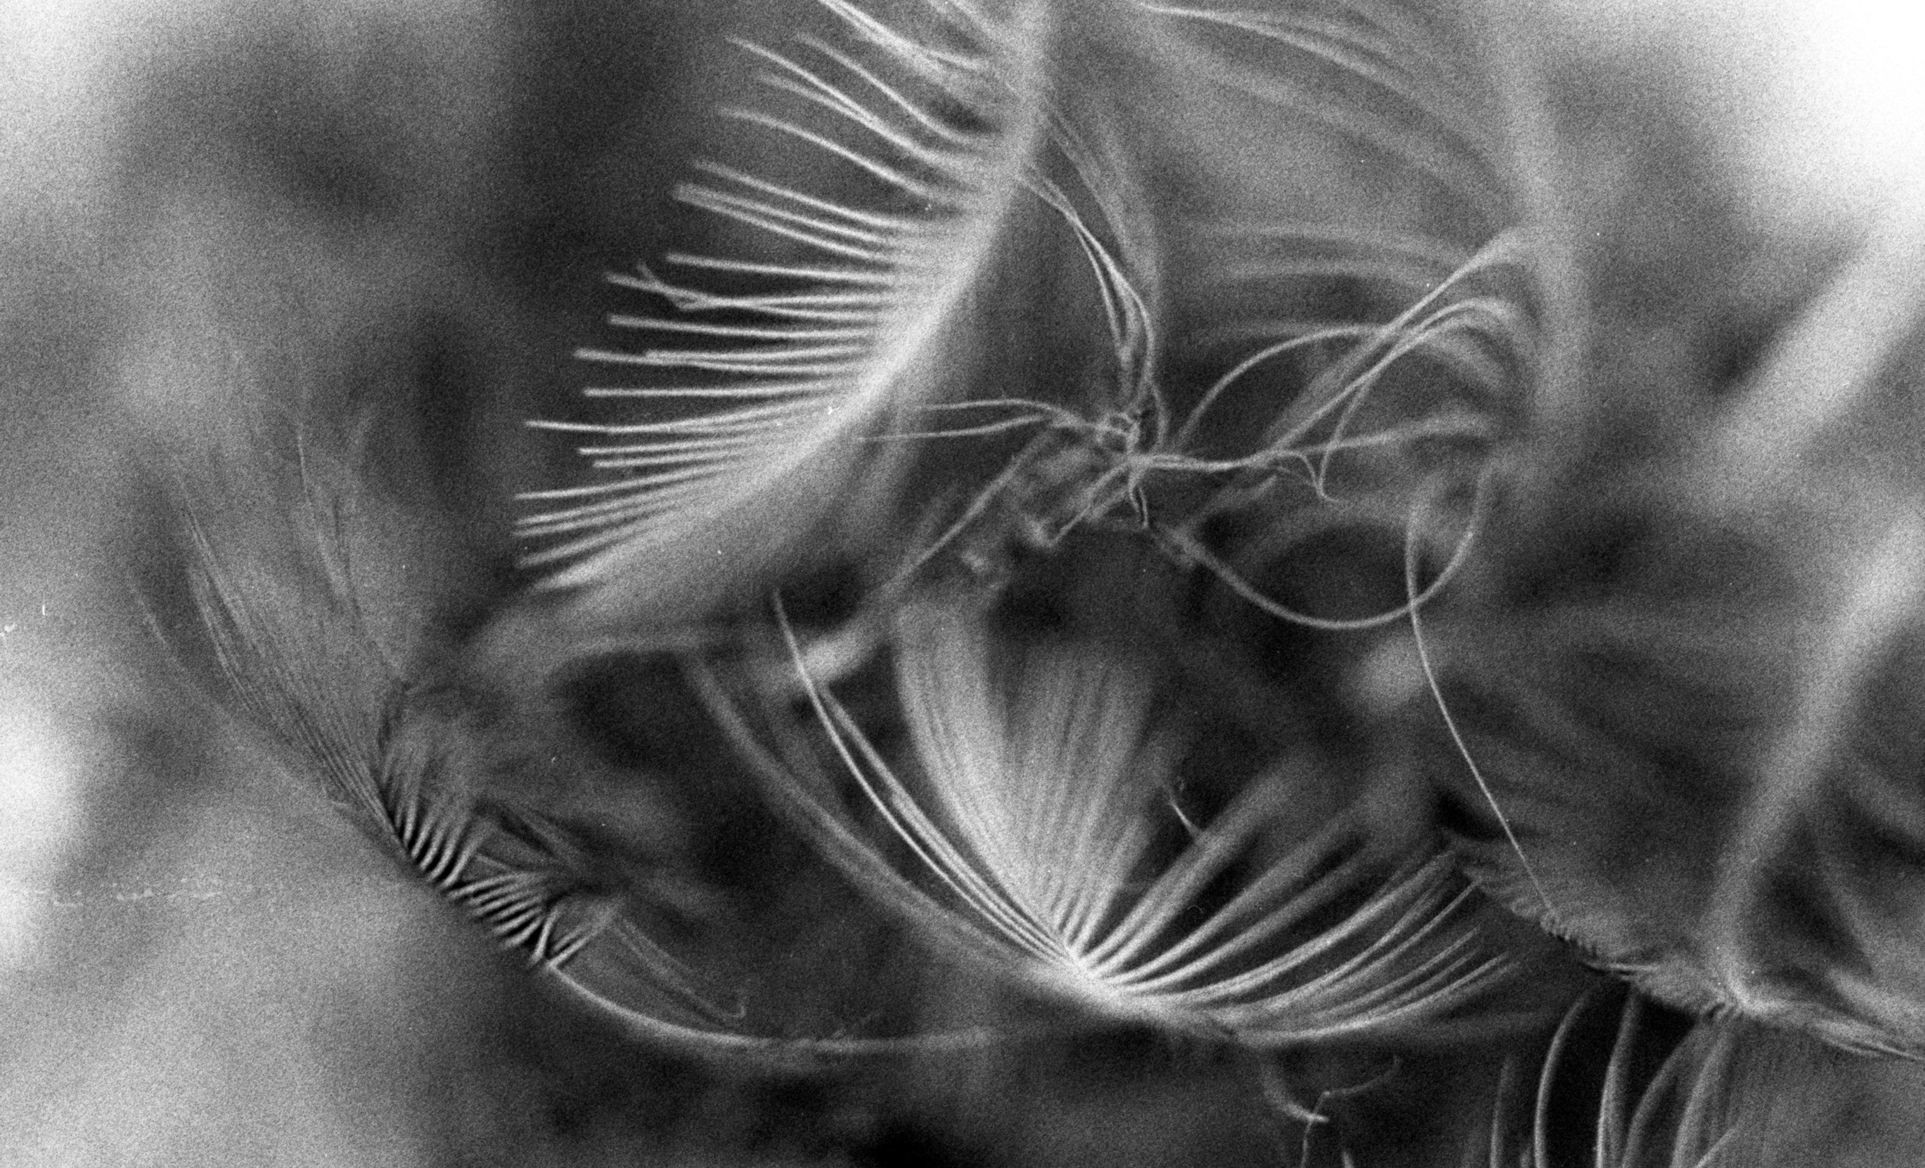
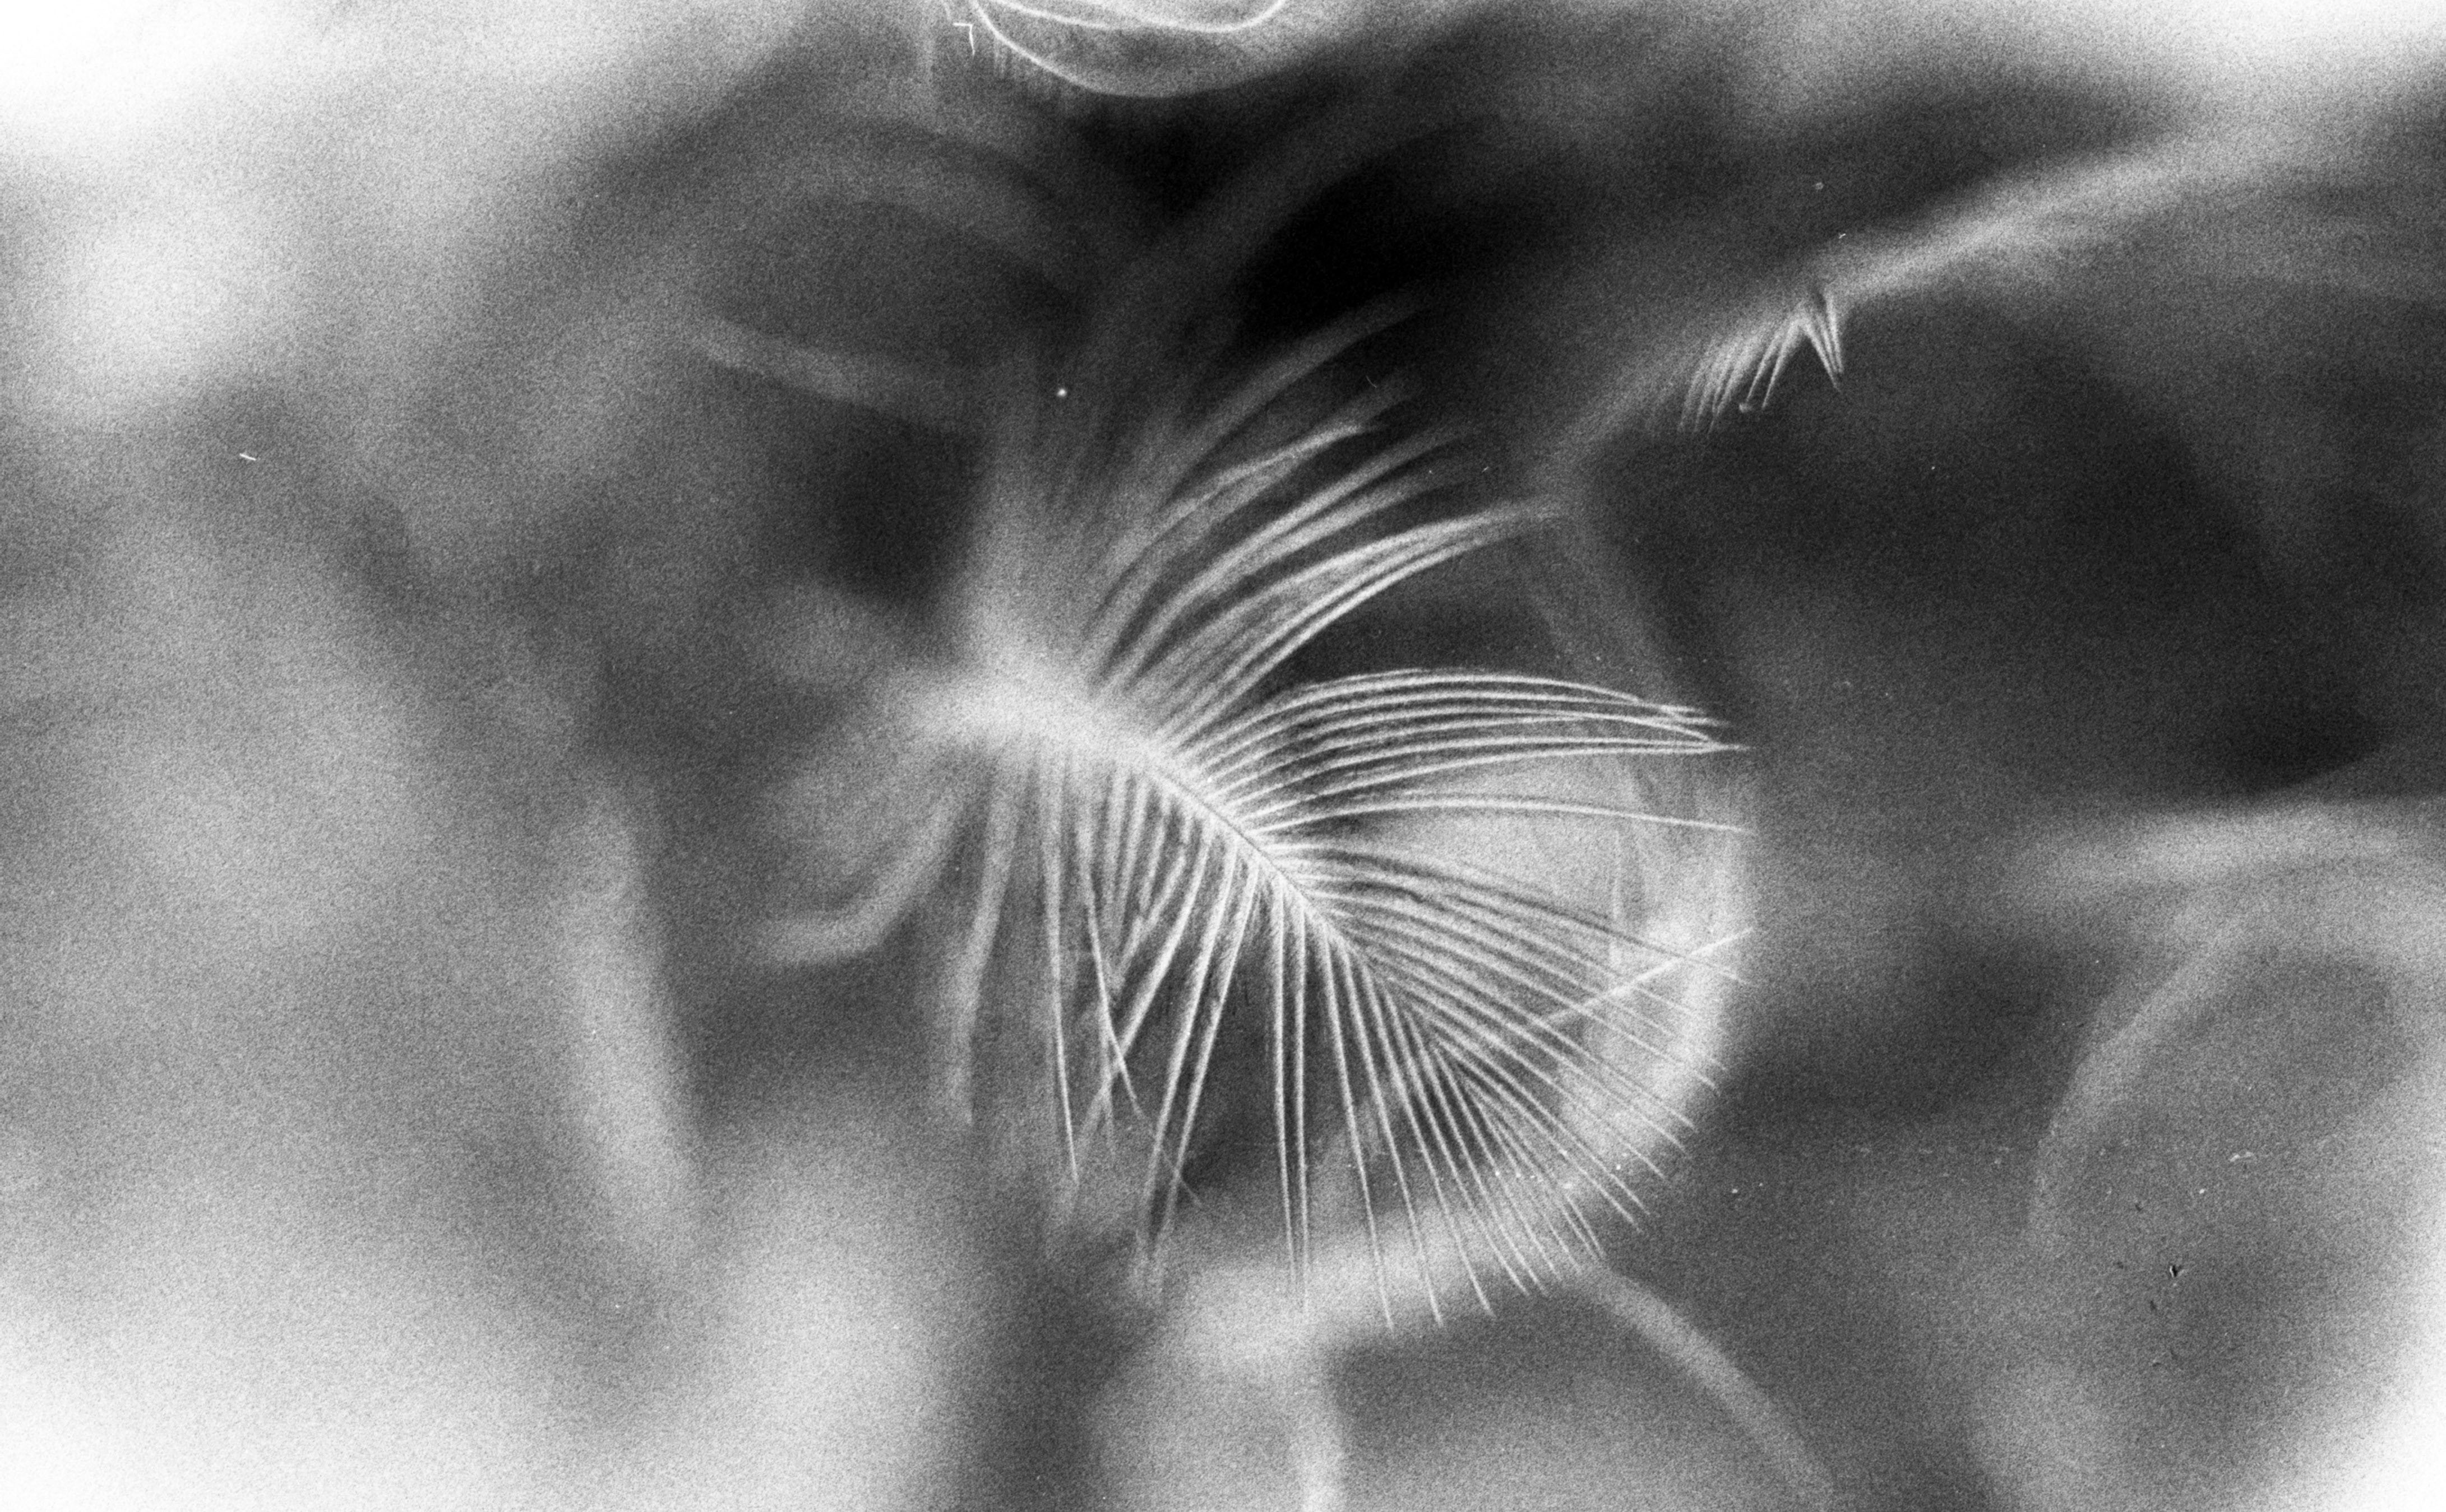
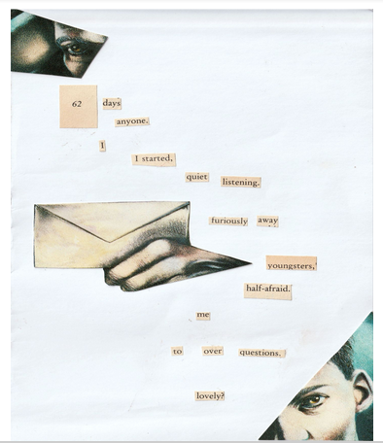

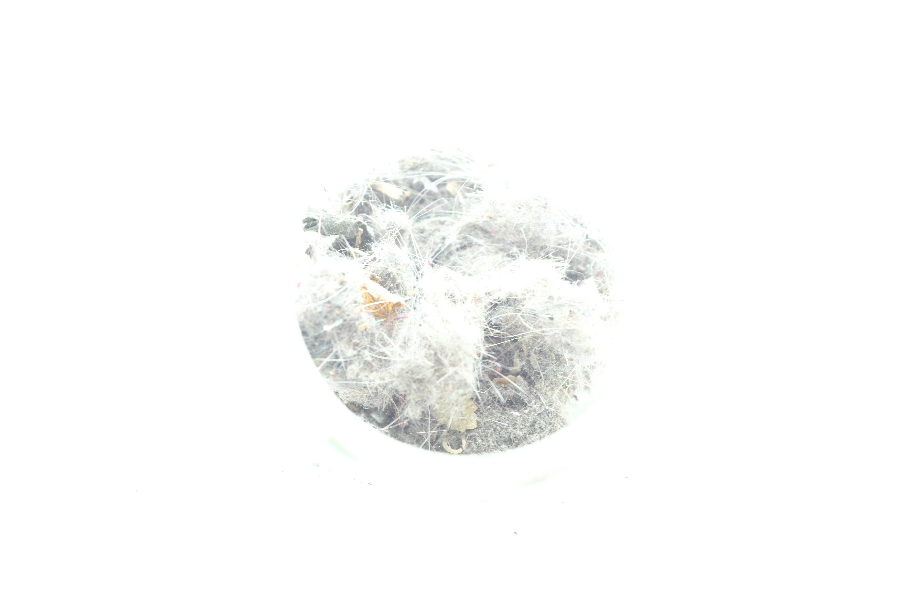
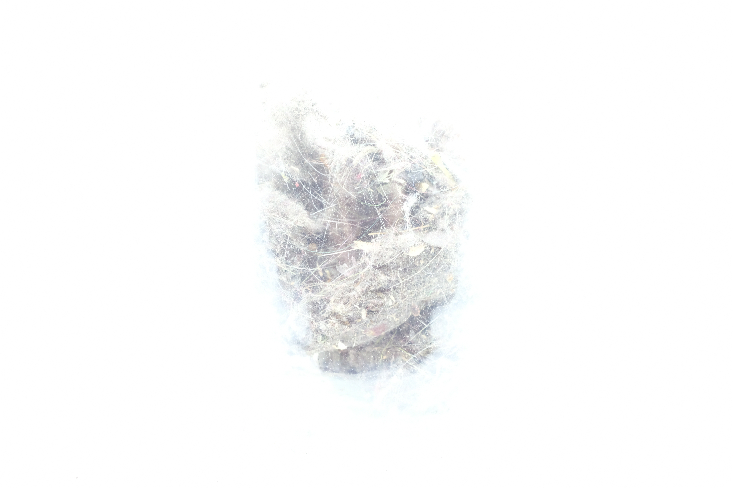
The book of life
ANALOGUE
POLAROID
OVEREXPOSED COMPOSITIONS
DADA POEM

Slide 7
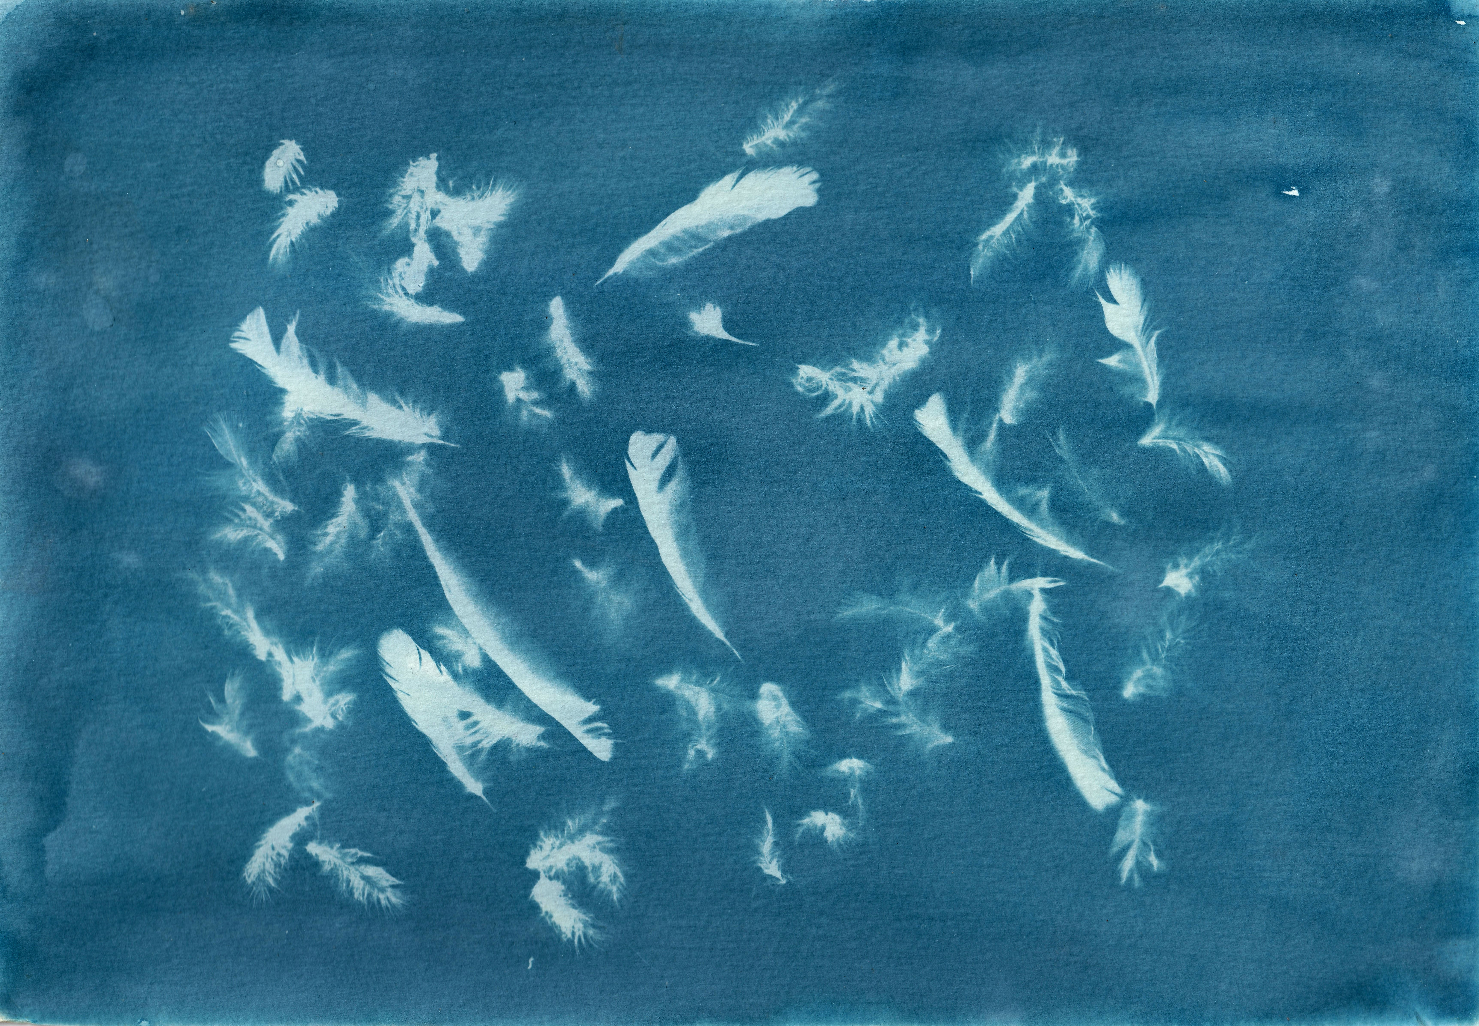
‘’Sometimes words can’t describe what I would like to express. Thinking about how to communicate better, the answer was art.‘’
Chiharu Shiota

Slide 8
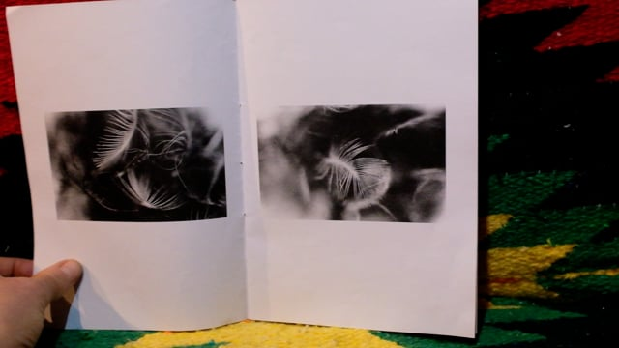
62 feathers

Slide 9
Stoicms
Making the distinction between what is within our power to influence, and what is not. Using this information we act on what can be acted upon, and we dismiss what can’t.

Slide 10
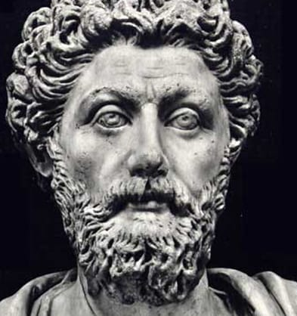
''Accept death in a cheerful spirit, as nothing but the dissolution of the elements from which each living thing is composed. If it doesn’t hurt the individual elements to change continually into one another, why are people afraid of all of them changing and separating? It’s a natural thing. And nothing natural is evil.”
Marcus Aurelius

